Slide 1
W should I contribute

Slide 2



Where do I start?
Search for project on Github
Google it
Join forums (Reddit, Gitter)

Slide 3
How should I start?

Slide 4
What can I contribute?
Sky is the limit
Open issue
Contribute with <place anything>
If you choose code

Slide 5



Clone it!
git clone <repo url>

Slide 6

Create Branch
git branch <new branch>

Slide 7

Create something cool

Slide 8

Test your cool thing

Slide 9

Commit your work
git add .
git commit -m “commit message”

Slide 10
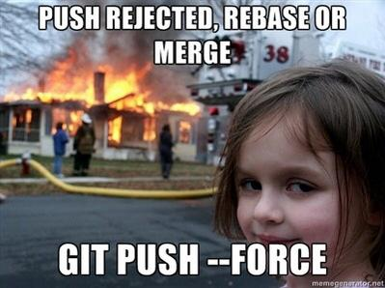
Push
git push <remote> <branch>

Slide 11

Merge
git merge <branch>

Slide 12
What if?!?!
You don't get response
Someone request change to your contribution
Your contribution get rejected
Your contribution get accepted!

Slide 13

Hooray!!!

Slide 14
What should I do next?
https://opensource.guide/how-to-contribute/
https://github.com/explore
Create your own project
Collaborate with friends

Slide 15


